Slide 1
Linked Lists

Slide 2
Ways in which linked lists differ from arrays
Array – each item occupies a particular position and can be directly accessed using an index number.
Linked list – need to follow along the chain of element to find a particular element. A data item cannot be accessed directly.
Array →
12
34
4
78
5
12
4
78
5
Linked List →
34

Slide 3
Applications of linked list in real world-
Image viewer – Previous and next images are linked, hence can be accessed by next and previous button.
Previous and next page in web browser – We can access previous and next url searched in web browser by pressing back and next button since, they are linked as linked list.
Music Player – Songs in music player are linked to previous and next song. you can play songs either from starting or ending of the list.

Slide 4
Applications of linked list in computer science –
Implementation of stacks and queues
Implementation of graphs : Adjacency list representation of graphs is most popular which is uses linked list to store adjacent vertices.
Dynamic memory allocation : We use linked list of free blocks.
Maintaining directory of names

Slide 5
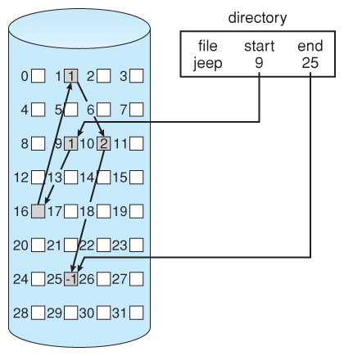
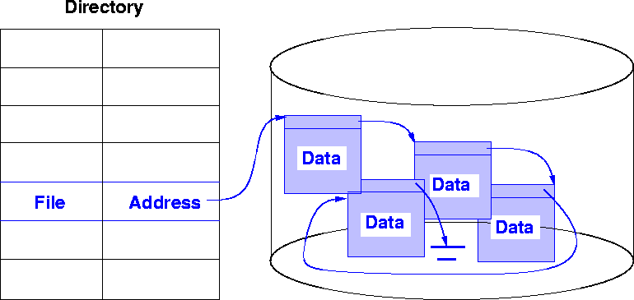
Linked Allocation in File System

Slide 6
Linked List
Linked lists are probably the second most commonly used general purpose storage structures after arrays.
Linked List Link Link Link Link
In a linked list each data item is embedded in a link.
There are many similar links.
Each link object contains a reference to the next link in the list.
In a typical application there would be many more data items in a link.
first
Data
next
Data
next
Data
next
Data
next
Null

Slide 7
Operations
Mainly the following operations can be performed on a linked list.
- Find
Find a link with a specified key value.
- Insert
Insert links anywhere in the list.
- Delete
Delete a link with the specified value.

Slide 8
Operations - Find
Start with the first item, go to the second link, then the third, until you find what you are looking for.
Ex: Find Item 35
Step 1 :
first
120
17
35
88
NULL
Found ? No
current
Step 2 :
first
120
17
35
88
NULL
Found ? No
current
Step 3 :
first
120
17
35
88
NULL
Found ? Yes
current

Slide 9
Operations – Insert
Inserting an item at the beginning of the list
Before inserting
first
120
17
NULL
Step 1 : create a new link
55
Step 2 : ‘next’ field of the new link points to the old first link
first
120
17
NULL
55
Step 3 : ‘first’ points to the newly created link
first
120
17
NULL
55

Slide 10
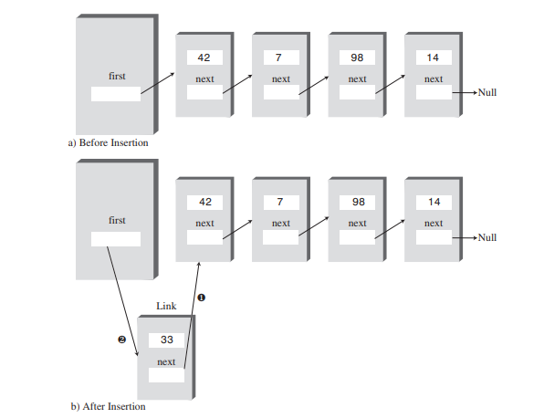
InsertFirst()

Slide 11
Operations - Insert
Inserting an item in the middle of the list
Before inserting
first
120
17
63
NULL
Question:
What steps need to be followed if a new link is inserted after the link ‘17’ ?

Slide 12
Operations - Delete
Deleting an item from the beginning of the list
Step 1 : Save reference to first link
first
120
17
35
NULL
temp
Step 2 : Disconnect the first link by rerouting first to point to the second link
first
120
17
35
NULL
temp
Step 3 : Return the deleted link (temp)

Slide 13
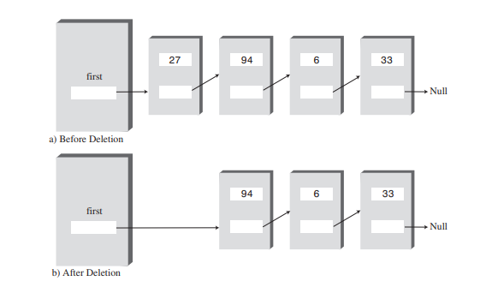
deleteFirst()

Slide 14
Operations - Delete
Deleting a given item from the list
first
120
17
35
NULL
Question:
What steps need to be followed to delete the link ‘17’ ?

Slide 15
Linked List - Implementation
Link Class
class Link {
public int iData; // data item
public Link next; // reference to the next link
public Link(int id) { // constructor
iData = id;
next = null;
}
public void displayLink() { // display data item
System.out.println(iData);
}
}
In a linked list, a link is an object of a class called something like “Link”.
There are many similar links in a linked list.
- Each link contains Data Items and a reference to the next link in the list.

Slide 16
Linked List - Implementation
Link List Class
class LinkList {
private Link first;
public LinkList() { //constructor
first = null;
}
public boolean isEmpty() { // true if list is empty
return (first == null);
}
// ……………………. other methods
}
The LinkList class contains only one data item, a reference to the first link on the list called ‘first’.
It is possible to find the other links by following the chain of references from ‘first‘, using each link’s next field.

Slide 17
Linked List - Implementation
Link List Class – Contd.
class LinkList {
private Link first;
public LinkList() { //constructor
first = null;
}
public boolean isEmpty() { // true if list is empty
return (first == null);
}
public void displayList() {
Link current = first;
while (current != null) {
current.displayLink();
current = current.next;
}
System.out.println(“ ”);
}
}
first
120
17
35
NULL
current

Slide 18
Linked List - Implementation
Link List Class – Contd.
class LinkList {
private Link first;
public LinkList() { //constructor
first == null;
}
public boolean isEmpty() { // true if list is empty
return (first == null);
}
public void displayList() {
Link current = first;
while (current != null) {
current.displayLink();
current = current.next;
}
System.out.println(“ ”);
}
}
first
120
17
35
NULL
current

Slide 19
Linked List - Implementation
Link List Class – Contd.
class LinkList {
private Link first;
public LinkList() { //constructor
first = null;
}
public boolean isEmpty() { // true if list is empty
return (first == null);
}
public void displayList() {
Link current = first;
while (current != null) {
current.displayLink();
current = current.next;
}
System.out.println(“ ”);
}
// insertFirst Method
public void insertFirst(int id) {
Link newLink = new Link(id);
newLink.next = first;
first = newLink;
}
// deleteFirst Method
public Link deleteFirst() {
Link temp = first;
first = first.next;
return temp;
}
}

Slide 20
Question 1
Write a program to
Create a new linked list and insert four new links.
Display the list.
Remove the items one by one until the list is empty.
(Use the LinkList class created)

Slide 21
Answer1
class myList {
public static void main(String[] args) {
LinkList theList = new LinkList(); // create a new list
theList.insertFirst(23); // insert four items
theList.insertFirst(89);
theList.insertFirst(12);
theList.insertFirst(55);
theList.displayList(); //display the list
while( !theList.isEmpty() ) { // delete item one by one
Link aLink = theList.deleteFirst();
System.out.print(“Deleted ”);
aLink.displayLink();
}
}
}

Slide 22
Double-Ended List
A double-ended list is similar to an ordinary linked list with an additional reference to the last link.
first
120
17
35
null
last

Slide 23
Doubly Linked List
A doubly linked list allows to traverse backwards as well as forward through the list.
Each link has two references.
first
next
120
17
35
null
previous

Slide 24
References
Mitchell Waite, Robert Lafore, Data Structures and Algorithms in Java,
2nd Edition, Waite Group Press,1998.

